Slide 1
Project 2
Exploratory Data Analysis (EDA)

Slide 2
First 10 Data entries
State | Rate | Verbal | Math
CT | 82 | 509 | 510
NJ | 81 | 499 | 513
MA | 79 | 511 | 515
NY | 77 | 495 | 505
NH | 72 | 520 | 516
RI | 71 | 501 | 499
PA | 71 | 500 | 499
VT | 69 | 511 | 506
ME | 69 | 506 | 500
VA | 68 | 510 | 501

Slide 3
Data Dictionary
State: (str, object)
The abbreviation of each State that has provided the data
Rate: (int64)
Some data. Related to the SAT scores, although this is unclear.
Verbal: (int64)
The average SAT score achieved in each State in Verbal grading.
Math: (int64)
The average SAT score achieved in each State in Mathematics grading.
Data_Shape: (52,4)
we have 52 counts of data for each of the 4 categories.

Slide 4
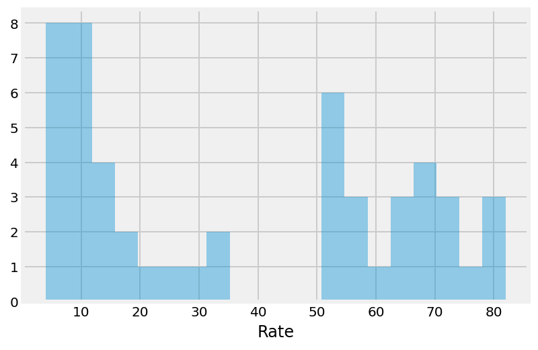
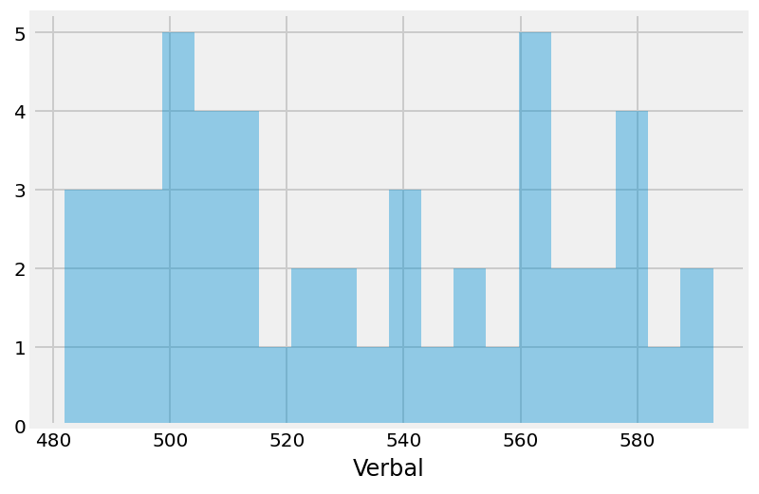
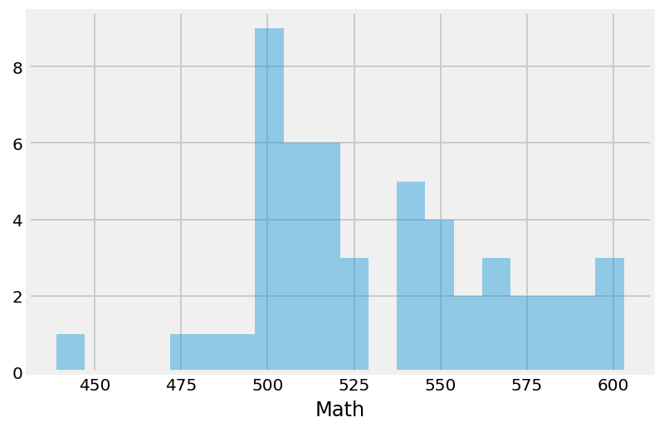
Distribution Graphs for each category.

Slide 5
Summary Table
 | Rate | Verbal | Math
count | 51.000000 | 51.000000 | 51.000000
mean | 37.000000 | 532.529412 | 531.843137
std | 27.550681 | 33.360667 | 36.287393
min | 4.000000 | 482.000000 | 439.000000
25% | 9.000000 | 501.000000 | 503.000000
50% | 33.000000 | 527.000000 | 525.000000
75% | 64.000000 | 562.000000 | 557.500000
max | 82.000000 | 593.000000 | 603.000000

Slide 6
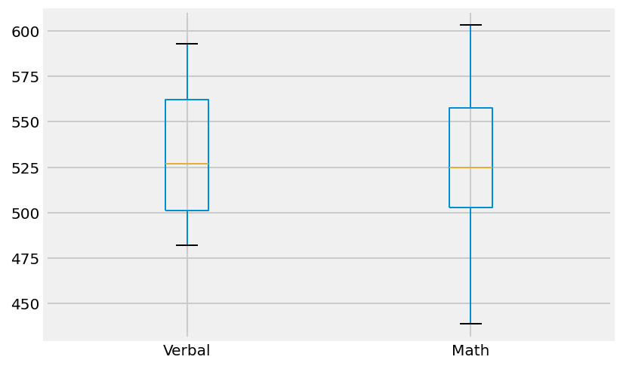
Box Plots- Verbal & Math SAT Scores

Slide 7
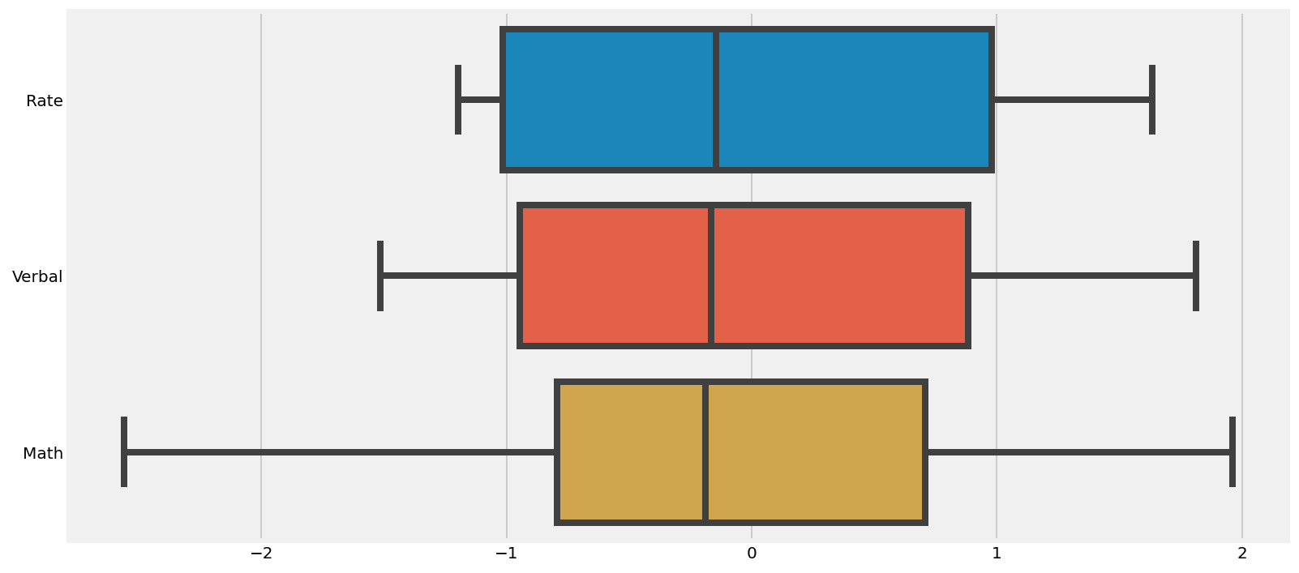
Standardized boxplots

Slide 8
List of States with scores above Mean Verbal SAT Scores
24 States | Rate | Verbal | Math
State
CO | 31 | 539 | 542
OH | 26 | 534 | 439
MT | 23 | 539 | 539
ID | 17 | 543 | 542
TN | 13 | 562 | 553
NM | 13 | 551 | 542
IL | 12 | 576 | 589
KY | 12 | 550 | 550
WY | 11 | 547 | 545
MI | 11 | 561 | 572
MN | 9 | 580 | 589
KS | 9 | 577 | 580
AL | 9 | 559 | 554
NE | 8 | 562 | 568
OK | 8 | 567 | 561
MO | 8 | 577 | 577
LA | 7 | 564 | 562
WI | 6 | 584 | 596
AR | 6 | 562 | 550
UT | 5 | 575 | 570
IA | 5 | 593 | 603
SD | 4 | 577 | 582
ND | 4 | 592 | 599
MS | 4 | 566 | 551

Slide 9
Largest difference in Verbal – Math scores
 | Rate | Verbal | Math | V-M
State
OH | 26 | 534 | 439 | 95
MS | 4 | 566 | 551 | 15
WV | 18 | 527 | 512 | 15
 | Rate | Verbal | Math | V-M
State
HI | 52 | 485 | 515 | -30
CA | 51 | 498 | 517 | -19
NJ | 81 | 499 | 513 | -14

Slide 10
Correlation table
 | Rate | Verbal | Math
Rate | 1.000000 | -0.888121 | -0.773419
Verbal | -0.888121 | 1.000000 | 0.899909
Math | -0.773419 | 0.899909 | 1.000000

Slide 11
End of SAT

Slide 12
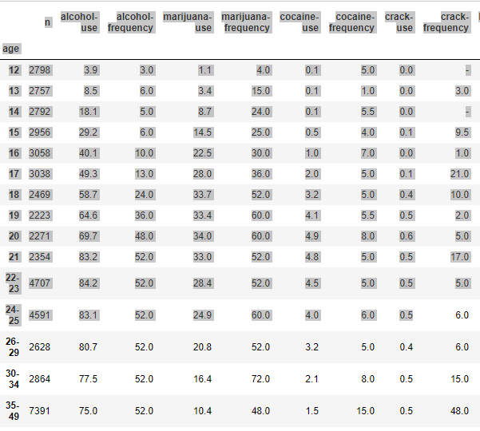
Drug Use By Age

Slide 13
Brief Data Dictionary
alcohol-use:
Percentage of those in an age group who used alcohol in the past 12 months
alcohol-frequency:
Median number of times a user in an age group used alcohol in the past 12 months

Slide 14
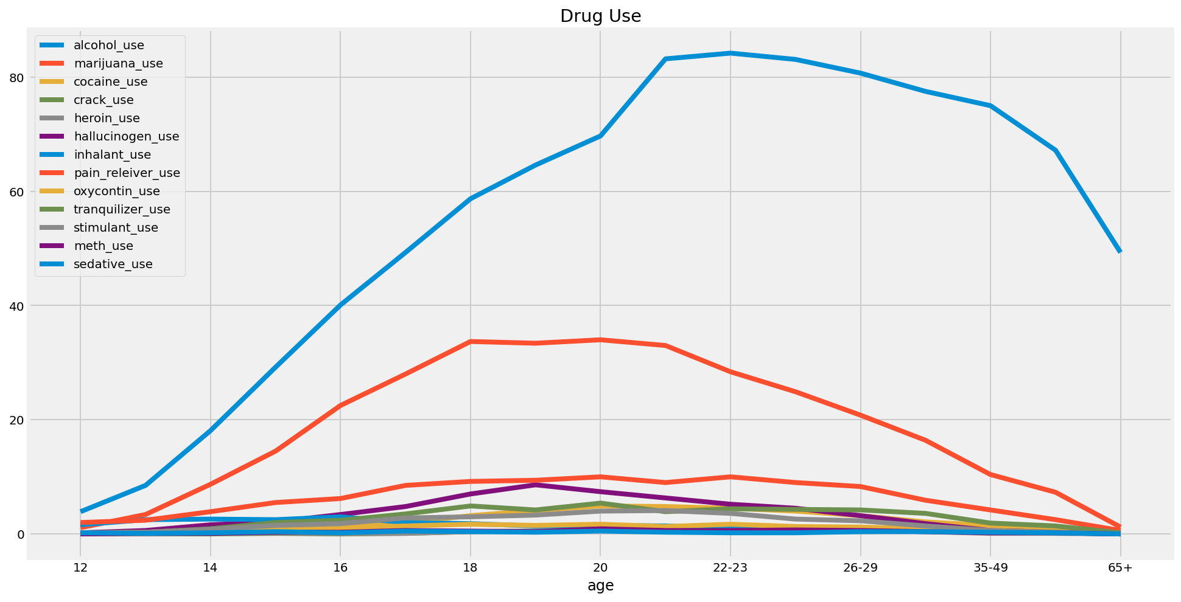
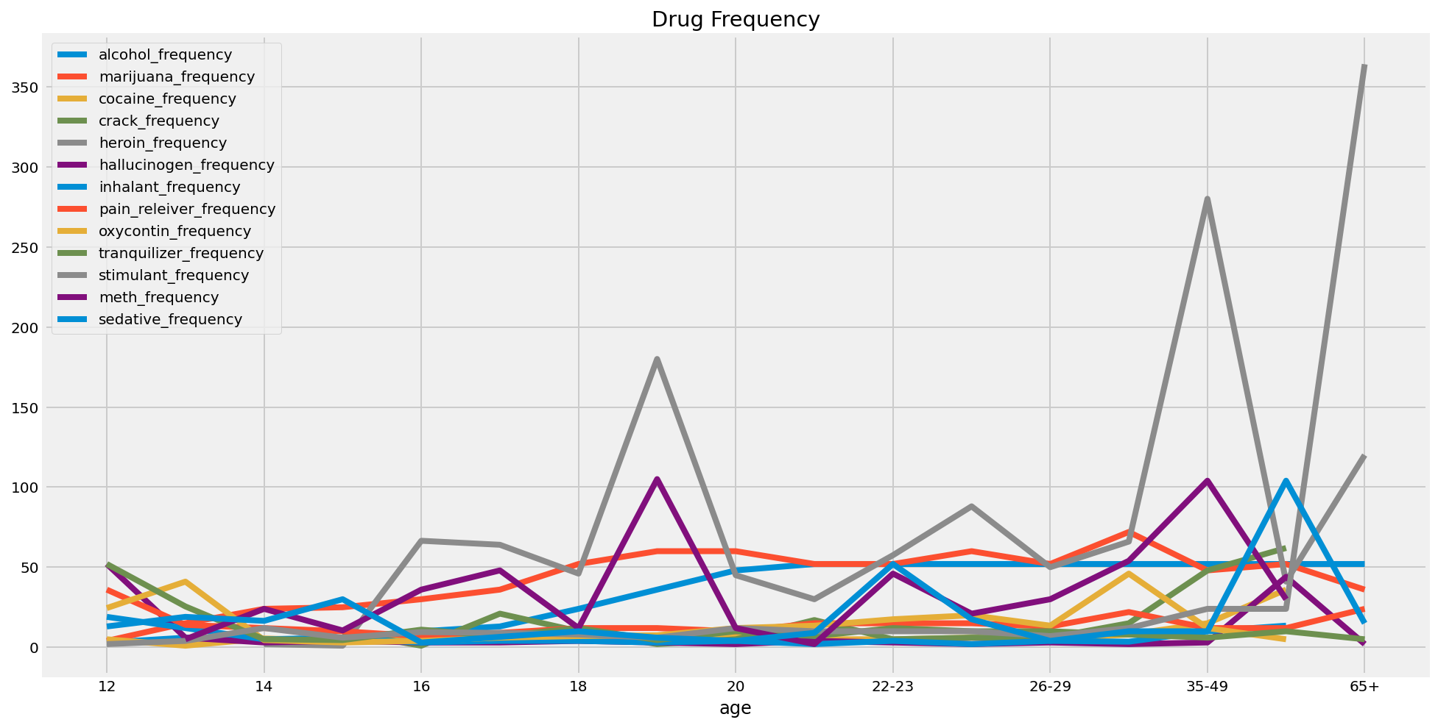
Use and Frequency by Age group

Slide 15
Use Summary
 | count | mean | std | min | 25% | 50% | 75% | max
alcohol_use | 17.0 | 55.429412 | 26.878866 | 3.9 | 40.1 | 64.6 | 77.5 | 84.2
marijuana_use | 17.0 | 18.923529 | 11.959752 | 1.1 | 8.7 | 20.8 | 28.4 | 34.0
cocaine_use | 17.0 | 2.176471 | 1.816772 | 0.0 | 0.5 | 2.0 | 4.0 | 4.9
crack_use | 17.0 | 0.294118 | 0.235772 | 0.0 | 0.0 | 0.4 | 0.5 | 0.6
heroin_use | 17.0 | 0.352941 | 0.333762 | 0.0 | 0.1 | 0.2 | 0.6 | 1.1
hallucinogen_use | 17.0 | 3.394118 | 2.792506 | 0.1 | 0.6 | 3.2 | 5.2 | 8.6
inhalant_use | 17.0 | 1.388235 | 0.927283 | 0.0 | 0.6 | 1.4 | 2.0 | 3.0
pain_releiver_use | 17.0 | 6.270588 | 3.166379 | 0.6 | 3.9 | 6.2 | 9.0 | 10.0
oxycontin_use | 17.0 | 0.935294 | 0.608216 | 0.0 | 0.4 | 1.1 | 1.4 | 1.7
tranquilizer_use | 17.0 | 2.805882 | 1.753379 | 0.2 | 1.4 | 3.5 | 4.2 | 5.4
stimulant_use | 17.0 | 1.917647 | 1.407673 | 0.0 | 0.6 | 1.8 | 3.0 | 4.1
meth_use | 17.0 | 0.382353 | 0.262762 | 0.0 | 0.2 | 0.4 | 0.6 | 0.9
sedative_use | 17.0 | 0.282353 | 0.138000 | 0.0 | 0.2 | 0.3 | 0.4 | 0.5

Slide 16
Frequency Summary
 | count | mean | std | min | 25% | 50% | 75% | max
alcohol_frequency | 17.0 | 33.352941 | 21.318833 | 3.0 | 10.000 | 48.00 | 52.000 | 52.0
marijuana_frequency | 17.0 | 42.941176 | 18.362566 | 4.0 | 30.000 | 52.00 | 52.000 | 72.0
cocaine_frequency | 16.0 | 7.875000 | 8.038449 | 1.0 | 5.000 | 5.25 | 7.250 | 36.0
crack_frequency | 14.0 | 15.035714 | 18.111263 | 1.0 | 5.000 | 7.75 | 16.500 | 62.0
heroin_frequency | 16.0 | 73.281250 | 70.090173 | 1.0 | 39.625 | 53.75 | 71.875 | 280.0
hallucinogen_frequency | 17.0 | 8.411765 | 15.000245 | 2.0 | 3.000 | 3.00 | 4.000 | 52.0
inhalant_frequency | 16.0 | 6.156250 | 4.860448 | 2.0 | 3.375 | 4.00 | 6.625 | 19.0
pain_releiver_frequency | 17.0 | 14.705882 | 6.935098 | 7.0 | 12.000 | 12.00 | 15.000 | 36.0
oxycontin_frequency | 16.0 | 14.812500 | 12.798275 | 3.0 | 5.750 | 12.00 | 18.125 | 46.0
tranquilizer_frequency | 17.0 | 11.735294 | 11.485205 | 4.5 | 6.000 | 10.00 | 11.000 | 52.0
stimulant_frequency | 17.0 | 31.147059 | 85.973790 | 2.0 | 7.000 | 10.00 | 12.000 | 364.0
meth_frequency | 15.0 | 35.966667 | 31.974581 | 2.0 | 12.000 | 30.00 | 47.000 | 105.0
sedative_frequency | 17.0 | 19.382353 | 24.833527 | 3.0 | 6.500 | 10.00 | 17.500 | 104.0

Slide 17
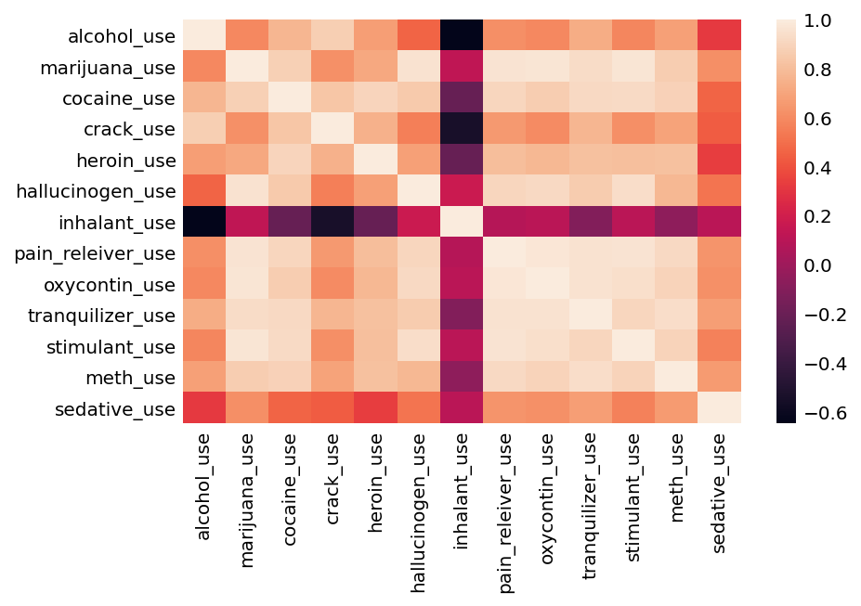
Correlation Heat Map - Use

Slide 18
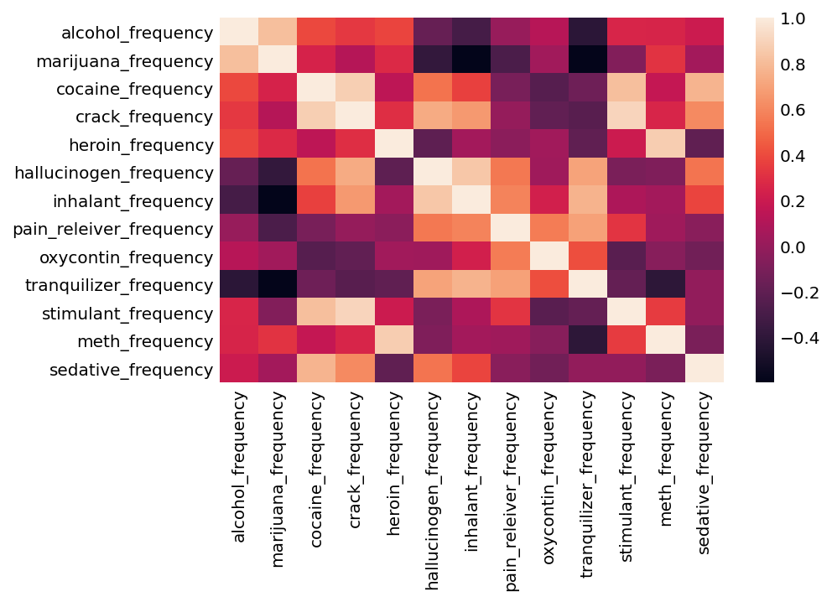
Correlation Heat Map - Frequency

Slide 19
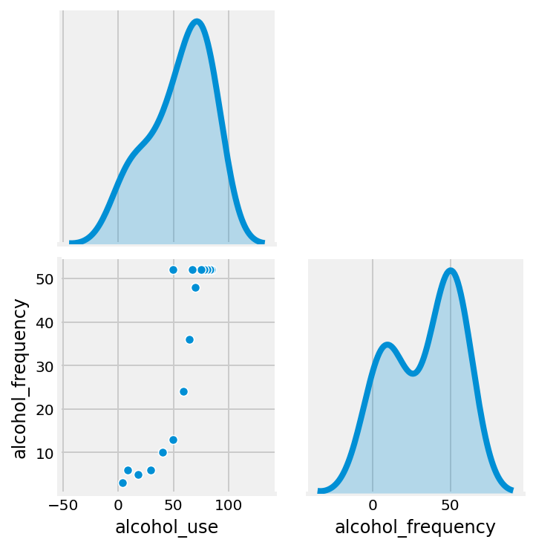
Correlation scatterplot

Slide 20
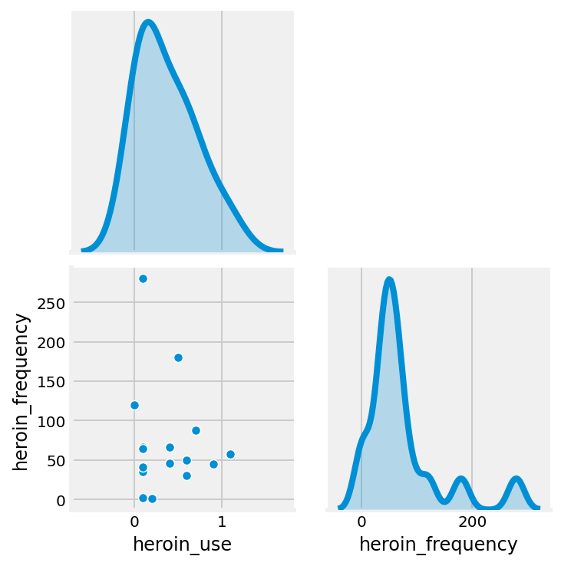
Correlation scatterplot

